Slide 1

Shanghai Metro
Group 1
2023.10.23

Slide 2

目 录
COMPANY
01
The Origin of Shanghai Metro
李沛轩
02
The development of Shanghai Metro
侯俊皓
03
The prospect of Shanghai Metro
项文涛
04
Shanghai Line 16 - Idiot subway in Shanghai Metro?
罗振宇

Slide 3
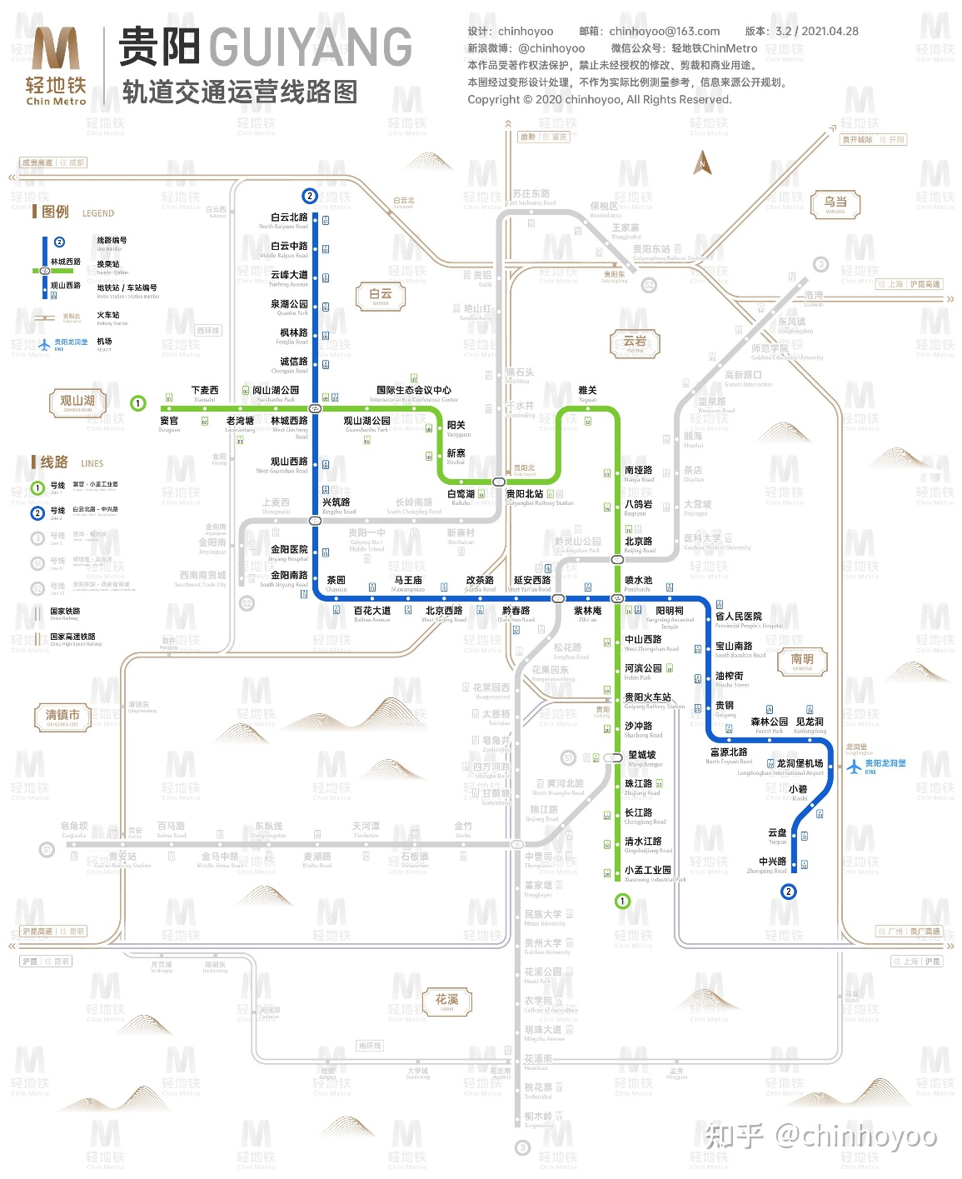
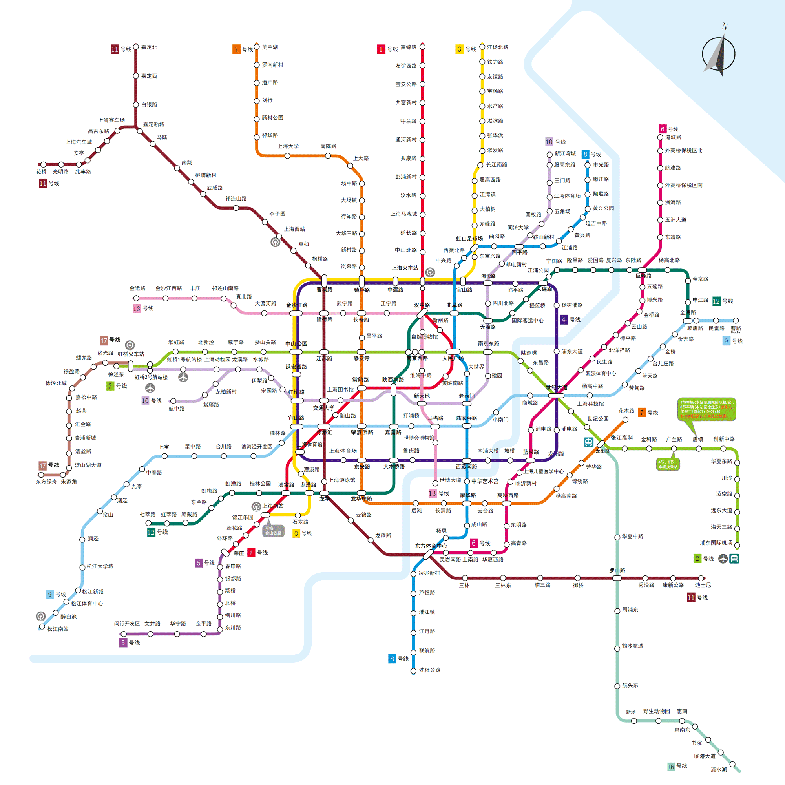

Slide 4
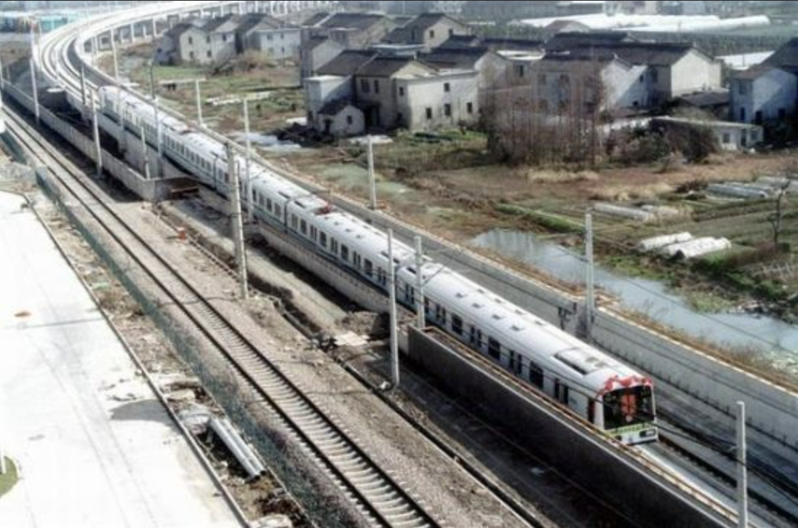
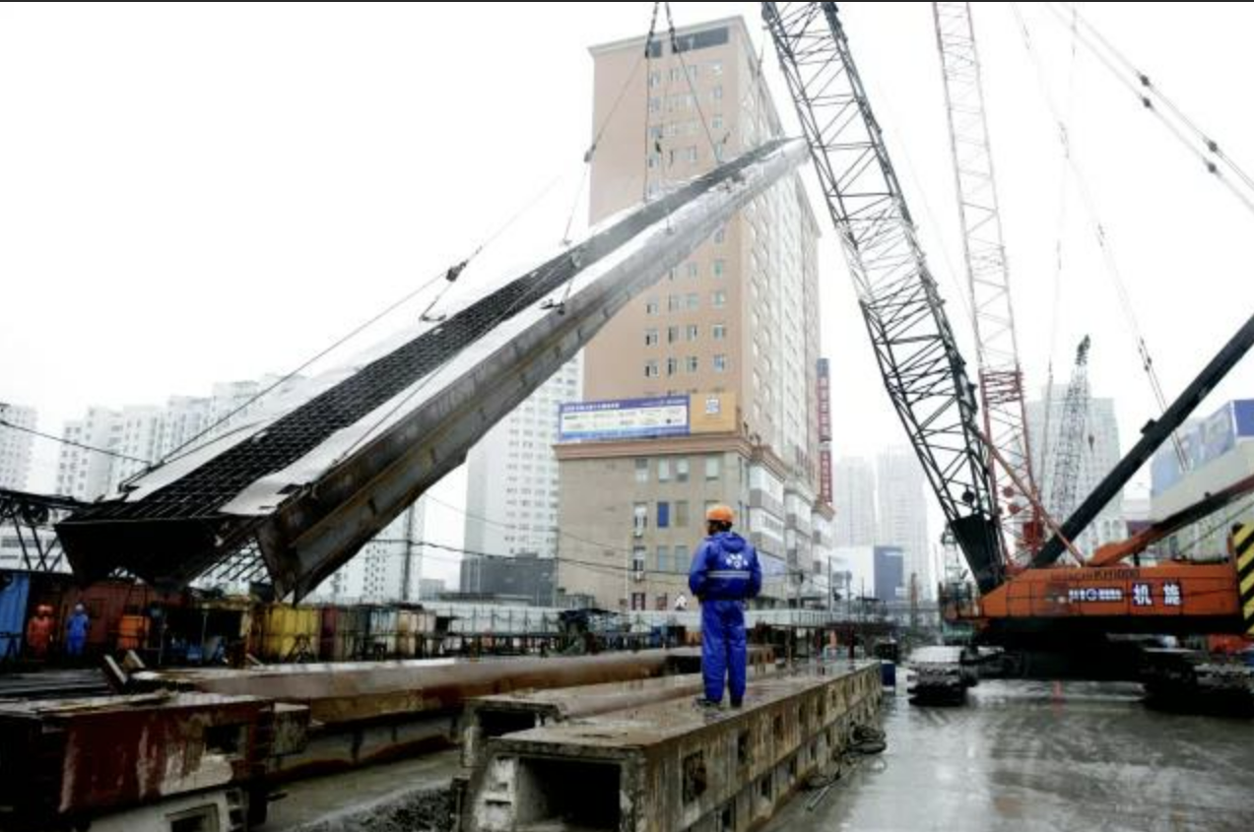
The Origin of Shanghai Metro
01
01

Slide 5
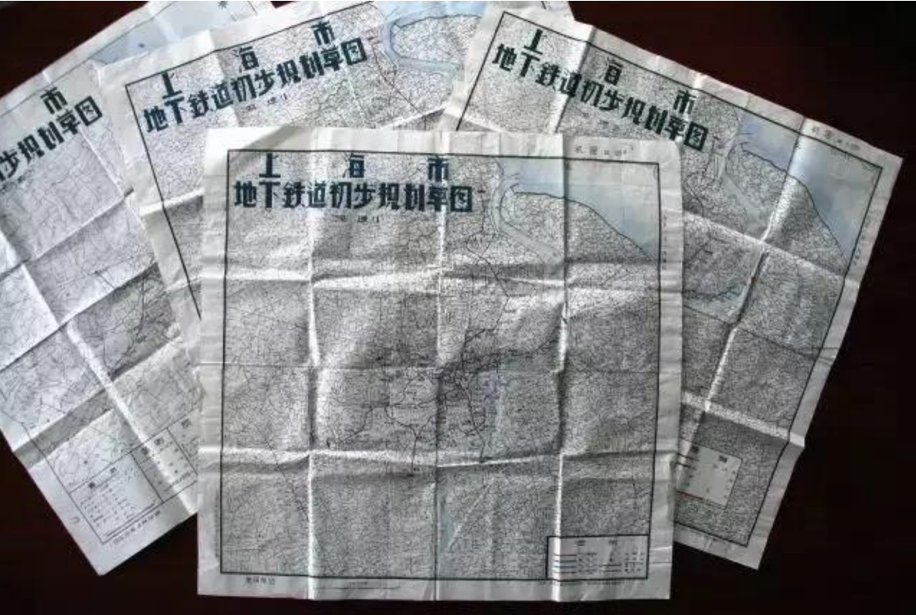

Part 1 The Origin of Shanghai Metro
the background of building Shanghai metro
On August 23, 1956, in accordance with the directives from the Central Committee of the Communist Party of China regarding the prevention of sudden imperialist attacks, the Shanghai Municipal Office of Urban Construction and Transportation (上海市政建设交通办公室)established the Shanghai Municipal Underground Railway Preparatory Office（上海市地下铁道筹建处）.
imperialist n.帝国主义 municipal 市政的

Slide 6
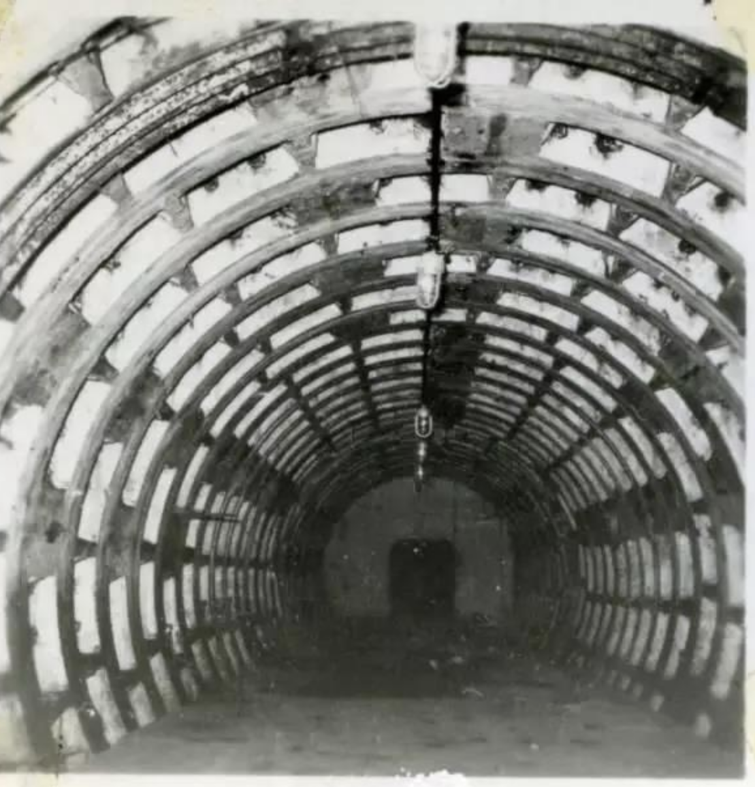

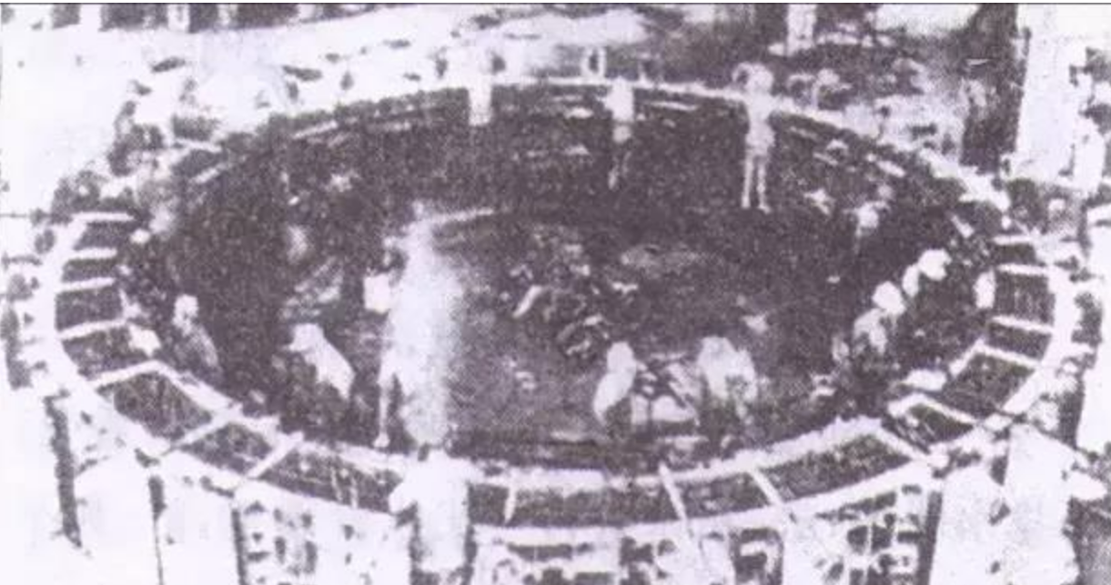
Part 1 The Origin of Shanghai Metro
The initial construction of the Shanghai Metro
From 1962 to 1983, Shanghai conducted three major-scale experiments in underground railway construction,as in the right 2 images.
On January 19, 1990, the construction of Shanghai Metro Line 1 officially began.
Over the following decade, a total of ten metro lines were completed.

Slide 7
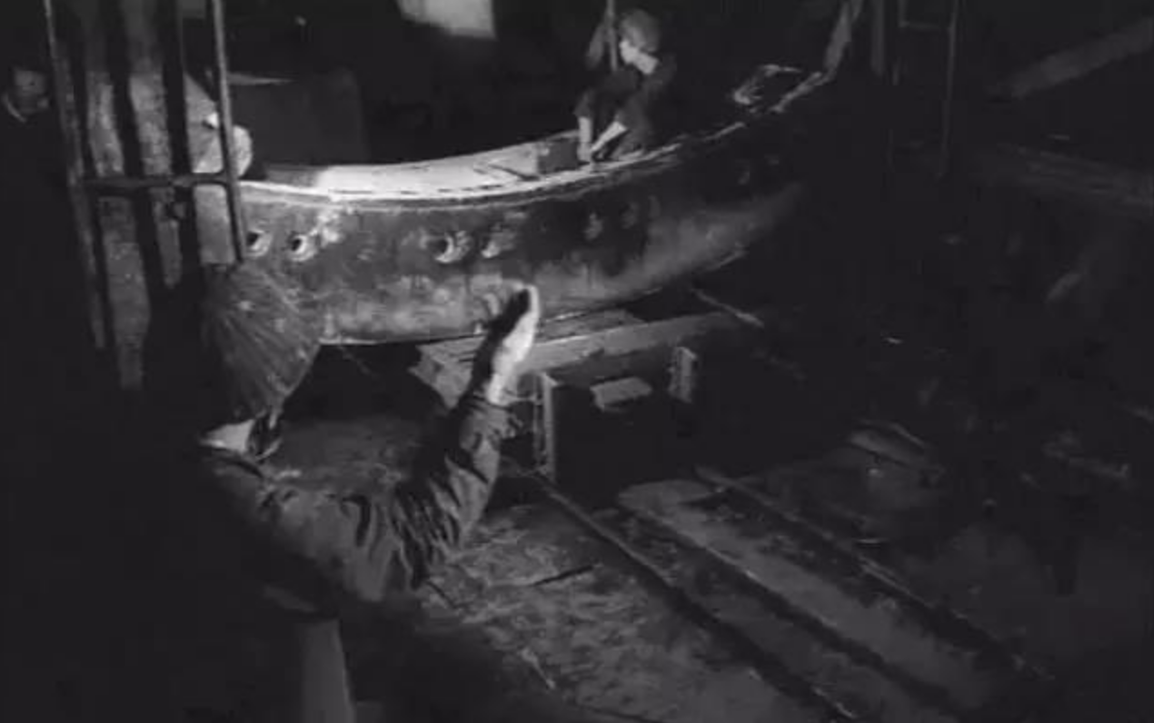

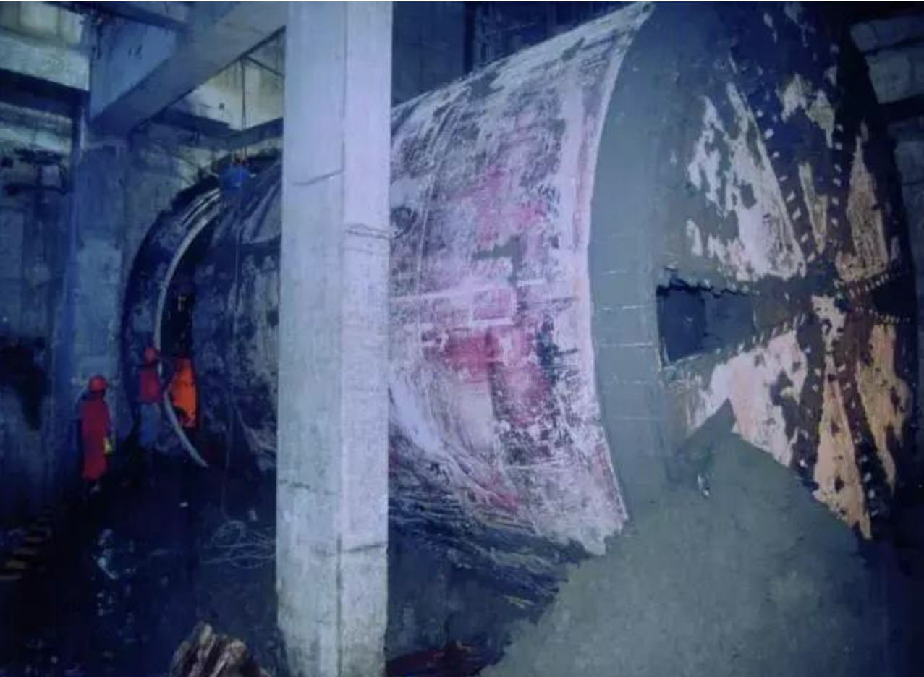
Part 1 The Origin of Shanghai Metro
In 1979, Mr. Liu Jianhang, an academician of the Chinese Academy of Engineering, , often referred to as the "Father of Chinese Tunnels" .took on the role of Vice General Manager and Chief Engineer .
On January 19, 1990, the construction of Shanghai Metro Line 1 began. This marked a significant milestone as it was the first subway line in China to be constructed using shield tunneling techniques.
盾构施工技术
Under his leadership, tunneling experts initiated the trial section of the Cao Bao Road Station (漕宝路站) for Metro Line 1,which provided valuable firsthand data for the construction of the Shanghai Metro.
上图为刘建航院士

Slide 8
The development of Shanghai Metro
02

Slide 9
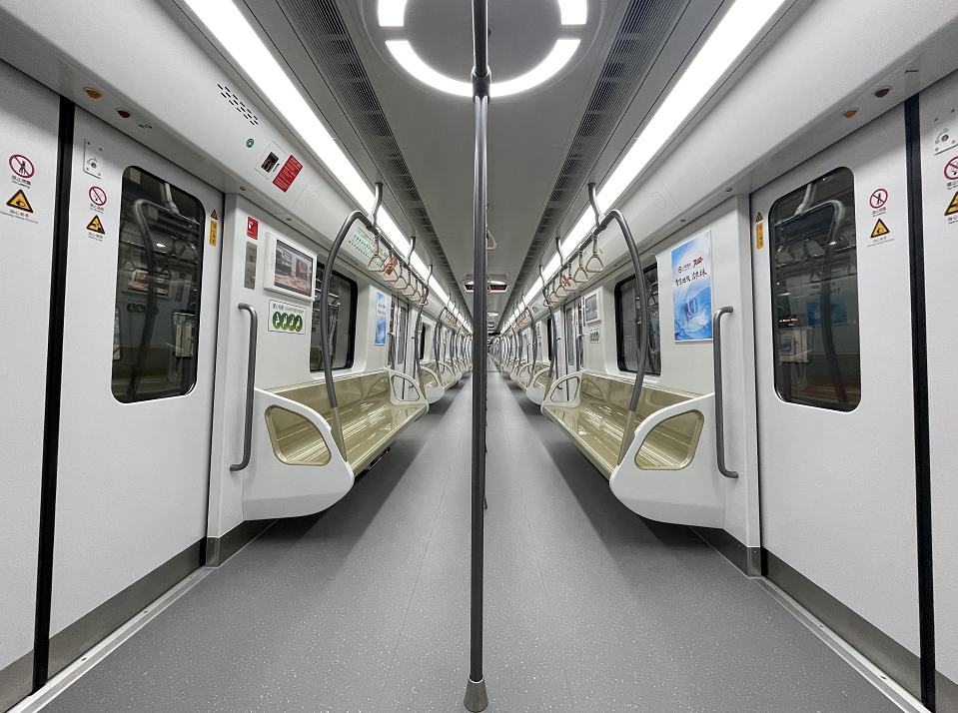

Part 2 The development of Shanghai Metro
expansions and upgrades
added new lines and stations
large-scale subway network

Slide 10
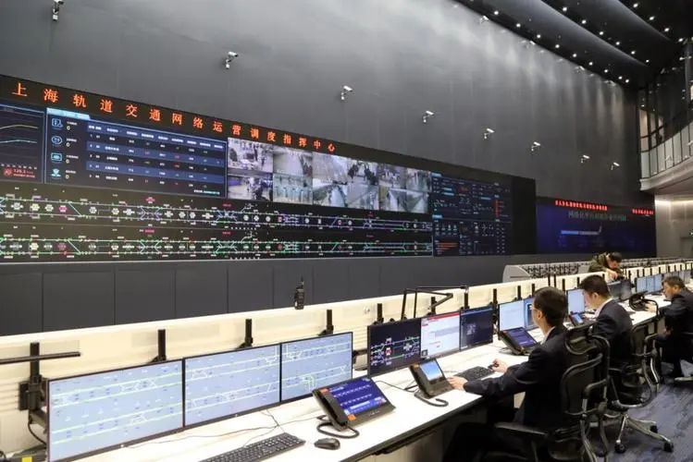
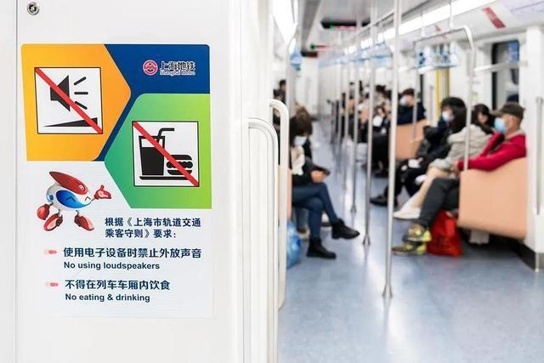
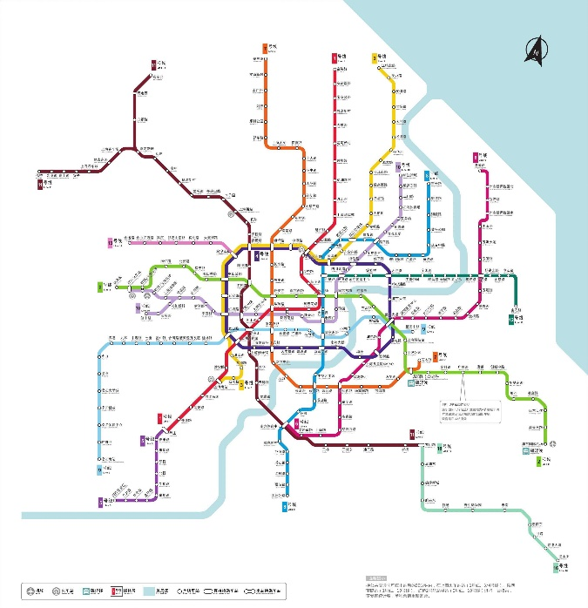
Part 2 The development of Shanghai Metro
December 12, 2007, the country's first rail transit network operation coordination and emergency command room was opened
In 2013, Shanghai's subway mileage reached 567.4 kilometers, ranking first in the world.
In 2016, the new version of the rail transportation technical standards were released

Slide 11
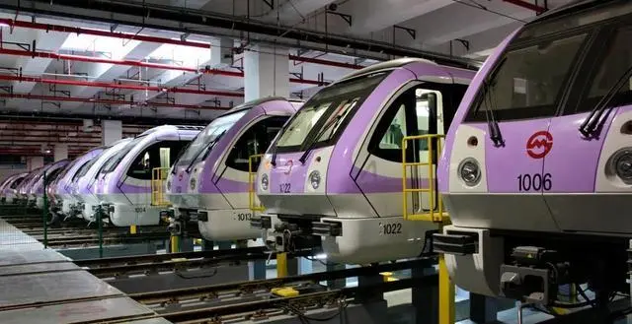
Part 2 The development of Shanghai Metro
a process of continuous innovation upgrading
reflects the development and progress of the city.

Slide 12
The prospect of Shanghai Metro
03

Slide 13
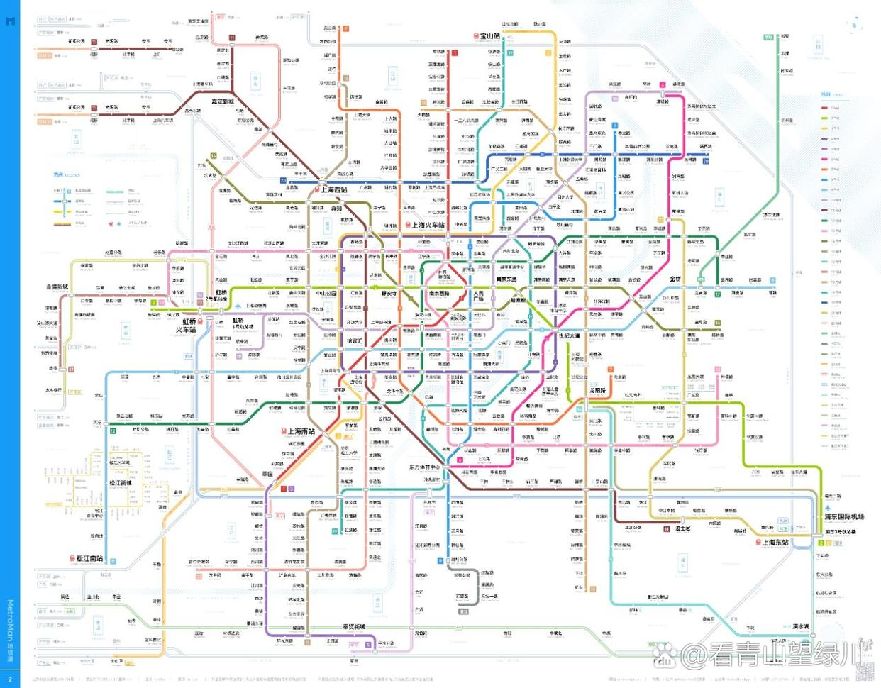

Slide 14

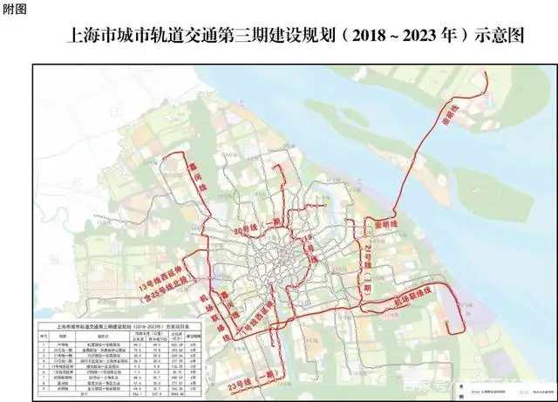
Part 4 The prospect of Shanghai Metro
The main purpose of future construction
1. Expansion of Rail Transit Network
2. Optimization of transfer nodes(换乘节点)
3. Interconnection of subway stations

Slide 15
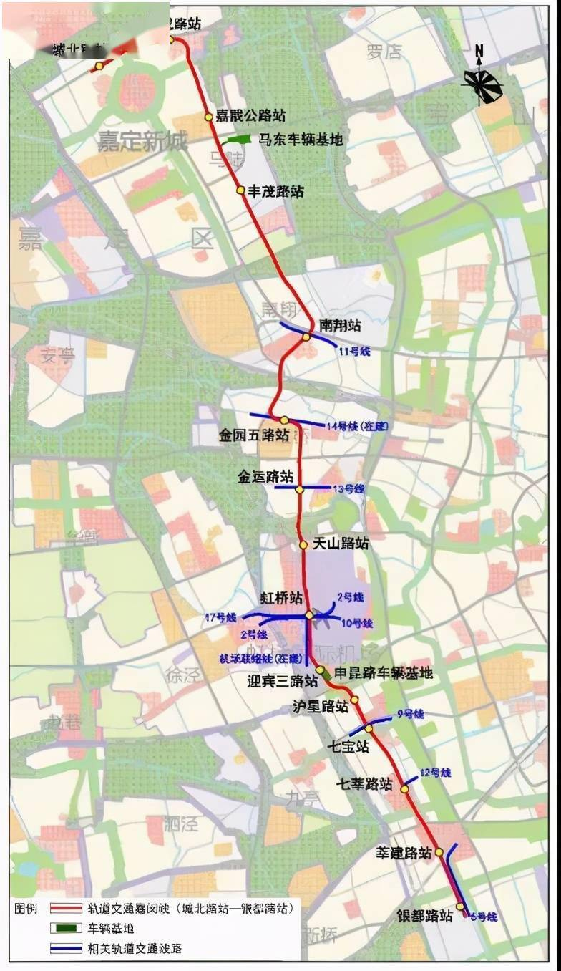
Part 4 The prospect of Shanghai Metro
The Jiamin Line
The project runs from Jiading North Station to Xinzhuang North Station, with a length of 41.6 kilometers and 15 stations. The investment is 37.101 billion yuan, and the project construction period is 6 years. It is expected to be completed in 2026. In addition, the Shanghai Jiamin Line will extends north to Taicang. This is the second urban railway in Shanghai that extends to surrounding cities (the first is the Huaqiao branch of Line 11)

Slide 16
Shanghai Line 16 - Idiot subway in Shanghai Metro?
（上海话：憨大儿子gang du ni zi）
04
01
Seating arrangement
02
network signalintensity（Network signal strength）
03
Line-16 is really Stupid or not？

Slide 17
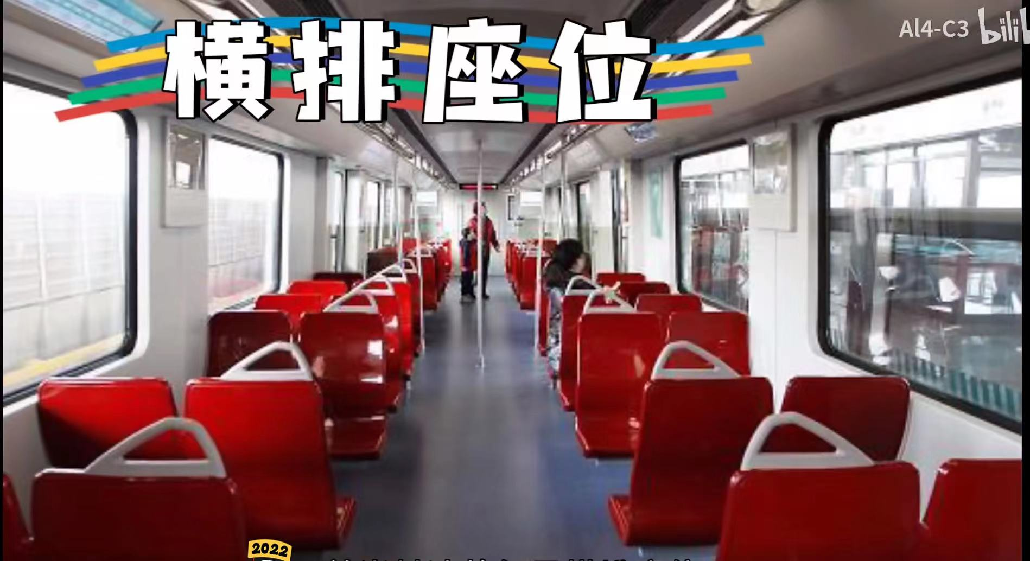



Seating arrangement
Few carriages
Sideways seating
Large passenger flow

Slide 18


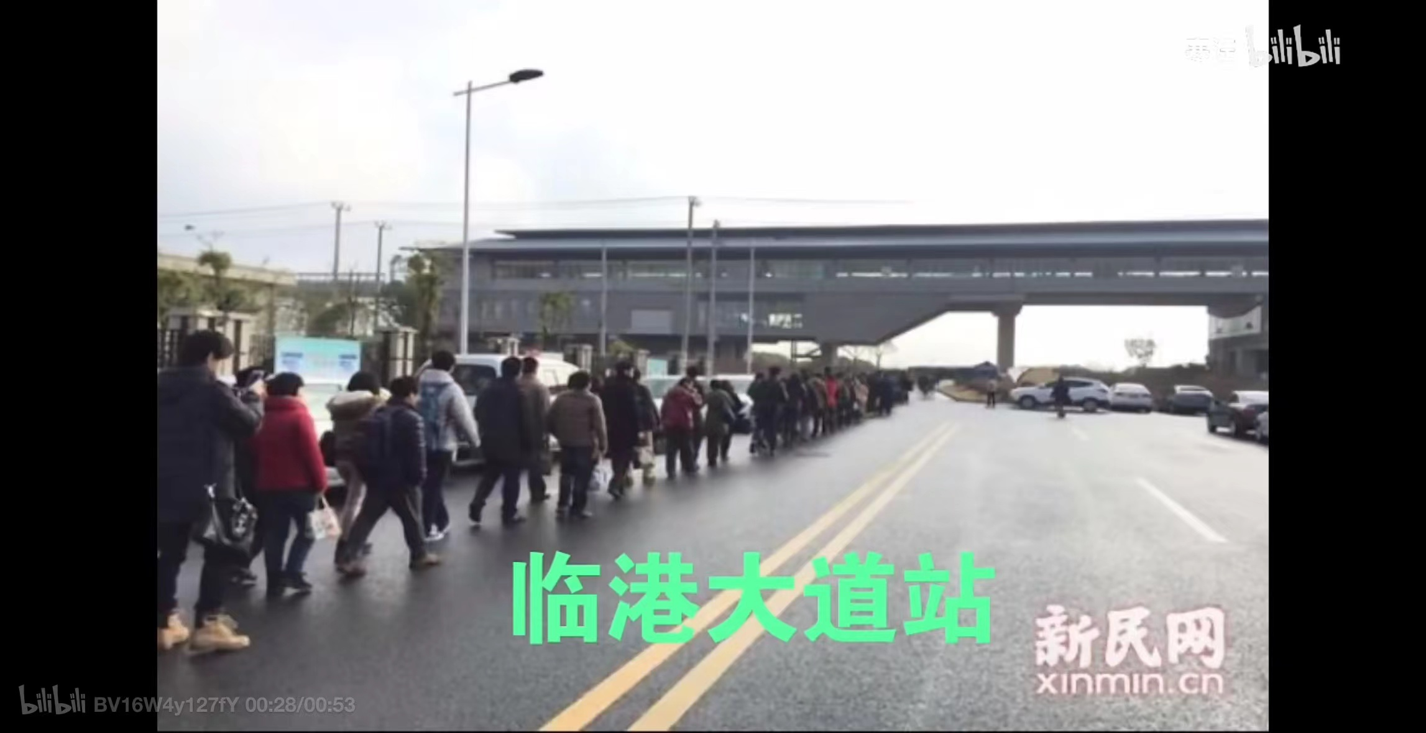





Cause problems
1、Low carrying capacity
2、Weak signal
标题标题
文字内容文字内容文字内容
文字内容文字内容文字内容

Slide 19
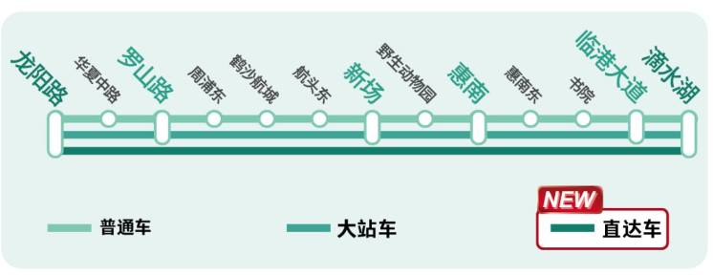

Line-16 is really Stupid or not？
1
2
3
Major station subway
High speed
Connecting the southeastern part of Shanghai
Reducing travel time to the destination
120km/h(Line-16)>80km/h(normal)

Slide 20
Conclusion
1
2
3
4
The Origin of Shanghai Metro
The development of Shanghai Metro
The prospect of Shanghai Metro
Shanghai Line 16 - Idiot subway in Shanghai Metro?
the historical backgroundmotivations and challenges
expanded and developed, advanced technologies
future
expansion technological
advancements
unique service coverage significance surrounding areas

Slide 21
THANKS

